Slide 1
ITSC 200 – Network Protocols and Security
Intoduction to Virtualization

Slide 2
Today’s Objectives
Learn about host-based and server-based virtualization
Create a virtual computer and install Linux

Slide 3
Software for Virtualization (on laptops)
We will be using a free application, from Sun Microsystems, called Virtualbox, which allows us to create ”fake” computers onto which we can install real operating systems.
Other options would be VMWare Workstation and the Hyper-V role in Windows 10.
Changes we make on the ”fake” (or virtual) computer have no affect on our real computer.
The operating systems we install ”think” that they are being installed on a real computer.

Slide 4
Software for Virtualization (on a remote server)
We will discuss server-based virtualization software that allows us to create virtual machines on a dedicated remote server.
An example would be a free server application called Proxmox, but there are others available, like VMWare ESXi server, and Hyper-V server (all are free).
The server-based virtualization products tend to be faster and allow us to run virtual machines 24/7

Slide 5
Virtual Machines
Remember that all hardware on a virtual machine is ”fake”.
This means we can add ”hardware” to our virtual machines as we please. Adding extra hard drives and network cards is done easily through virtualbox.
Virtual machines ”talk” to the network just like real machines except that we have more control over how they do it.

Slide 6
Virtual Machine Networking
Virtual network cards can be one of three types:
Host-only : the virtual machine can only talk to other virtual machines running on the same real machine. They can also talk to the real machine.
Bridged : the virtual machine is a full member of the network and can both talk to, and be talked to by other real and virtual machines on the network. To external computers, these virtual computers appear as real computers on the network.
NAT : the virtual machine can talk to other real and virtual machines on the network but cannot be seen by them. It is almost as if the virtual computer is behind a firewall.

Slide 7
Virtual Computers
First we create a virtual computer of the right type (Linux Ubuntu 64).
Next, we install an operating system on it just as we would with a real computer.
Once the virtual machine is running with an operating system (Linux Mint 64), we can use is as we would any other real computer.
Notes:
1

Slide 8
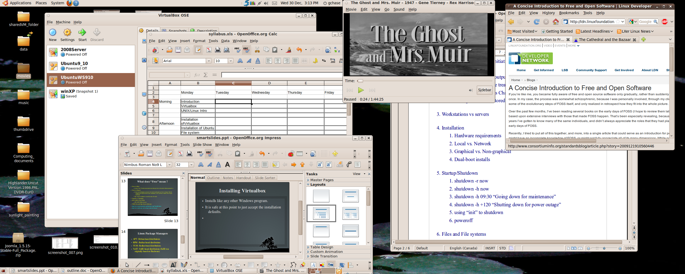
Notes:
1

Slide 9
Virtual Computers
One of the nice things about using a virtual machine (VM) is that we can suspend it, then later on continue where we left off.
When we suspend a VM, we are simply pausing it and everything (hard drive, RAM, time, etc.) is in a suspended state until we resume it.
We can also add virtual hardware to a VM. So if we need another hard drive or network card it is trivial to add it.

Slide 10
Virtual Computers
Generally, virtual RAM and hard disks start out actually being quite small in the VM.
As we use more RAM or hard drive space, the actual files (representing the virtual hard drive) and actual RAM memory in the host operating system dynamically grow larger. So a VM that is assigned 4 Gb of RAM might actually use only 1 Gb of actual RAM while running.

Slide 11
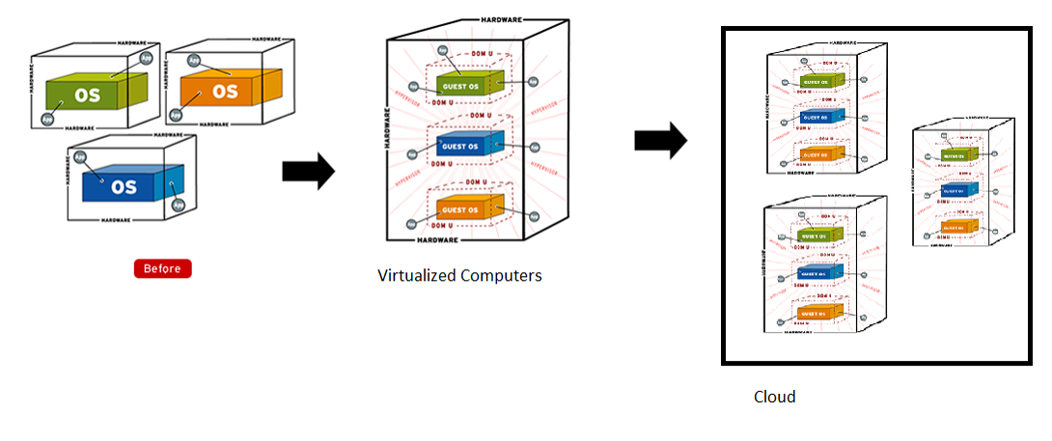
Virtual Machines and Clouds

Slide 12
Virtualbox
How to create a virtual machine on your laptop.
Create a new VM in Virtualbox
Create the VM for the correct operating system
Add virtual hardware to VM
Decide hard disk, RAM, and networking options
Attach an install ISO (image of a CD or DVD) to the VM’s virtual CD/DVD drive so we have installation media.
Start the VM. At this point, it thinks that it is a brand new machine without an operating system (which is true).
Install the operating system.

Slide 13
Coffee Break!

Slide 14
Introduction to Cloud Computing

Slide 15
Public Cloud
A public cloud is a utility which offers users a platform to run computing services on.
The platform is abstracted from the users so that they do not have to be concerned about hardware, backups, or networking.
The largest examples of public clouds would be AWS (Amazon Web Services), Google Cloud, and Microsoft’s Azure Cloud.

Slide 16
Clouds can be Expensive
All of the cloud providers listed in the previous slide are commercial providers.
Their services are not free, and can be very expensive depending on the levels of services that you select and use.

Slide 17
Cybera Cloud
The Government of Canada realized a few years ago that having the use of a public cloud could encourage entrepreneurs and researchers to develop products and solutions that would have been difficult without a cloud environment, or prohibitively expensive if they used a commercial cloud.

Slide 18
Cybera Cloud
The Federal government established the Canarie high-speed network which connects each of the provinces and Alberta implemented the Cybera Cloud as a semi-public cloud that users can use for free.
Cybera Cloud is implemented using Openstack, an open-source cloud implementation.

Slide 19
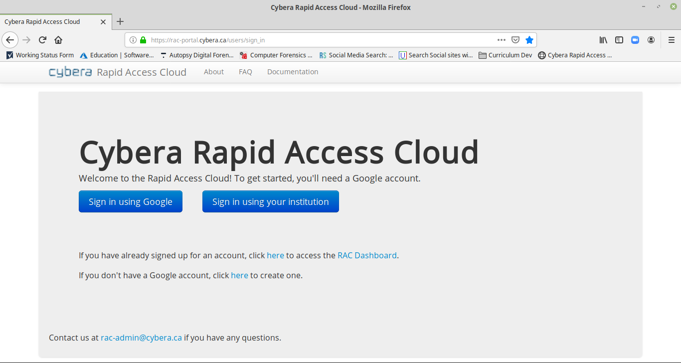
How to Use Cybera
You will need a Google account to create an account on Cybera.

Slide 20
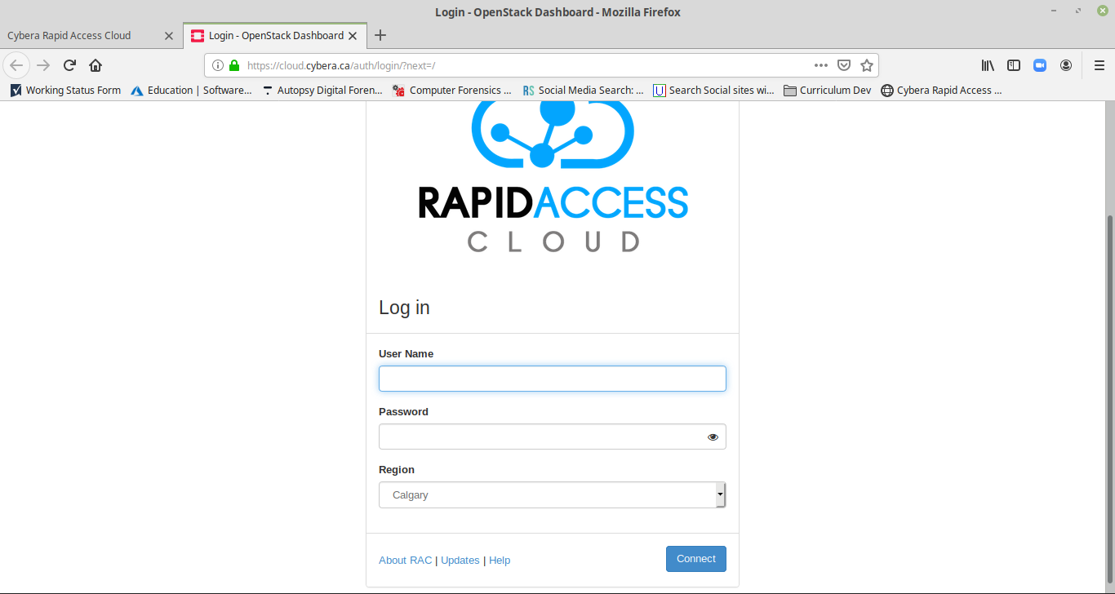
How to Use Cybera RAC
Once you create the account, you can login.

Slide 21
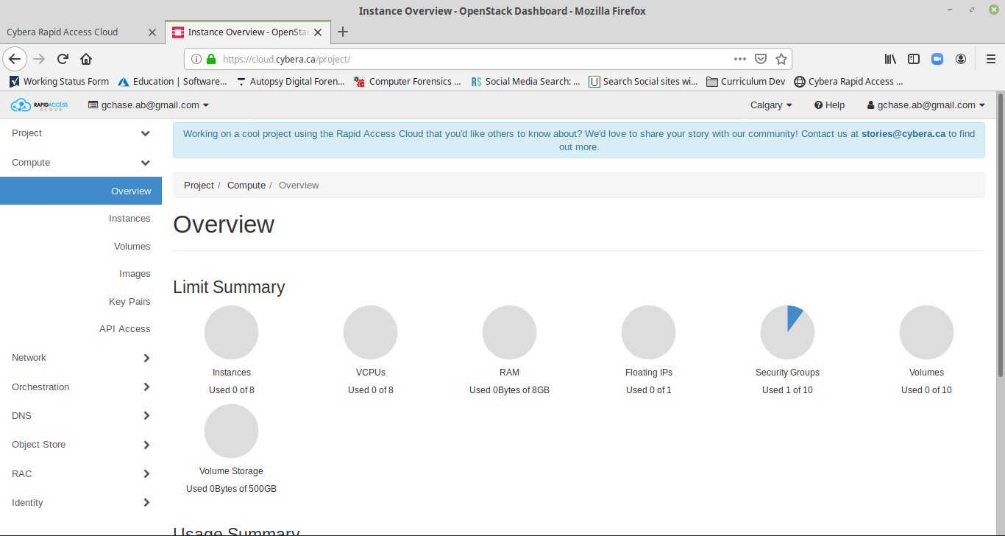
Cybera RAC Dashboard

Slide 22
Using Cybera RAC
There is a bit of preparation that you must do in order to use RAC and there is a document (setting_up_and_using_a_rac_account.docx) on the course website that will assist you through the process.

Slide 23
Some Important Concepts
While initially, RAC may look much the same as Vmware Workstation or Virtualbox, there are some very important differences.
The main difference – you do not “create” virtual machines. You start “instances” of virtual machines using pre-defined “images” that are immutable.

Slide 24
Some Important Concepts
The next major difference – the instances that you start running from images, are ephemeral.
Once they are shutdown, any changes you have made to the instance are gone.
There are ways to save your changes, but the default behaviour of instances is to discard changes on shutdown.

Slide 25
Some Important Concepts
Running instances, by default, will have a public IPv6 and a private IPv4 address.
So that means that running instances are running in “NAT” mode by default if using IPv4 and “Bridged” if you are using IPv6.
If you need static data to be available to a running instance, you can create a “volume” which is like a separate hard drive that you can attach to any running instance.

Slide 26
Some Important Concepts
Generally, passwords are not used on cloud-based instances. Because instances are simply running “copies” of images, every running instance of an image would have the same password.
Worse, if we changed the password it would be lost anyway since changes to instances are discarded on shutdown.

Slide 27
Some Important Concepts
To get around this problem, we use public/private key pairs.
The public/private key pair is generated and used by the cloud to verify a user. The private key stays in the possession of the user.
When the user starts an instance, they “inject” their public key into the running instance, then their private key is used to access the admin account of the running instance.

Slide 28
Some Important Concepts
Another difference from other virtualization platforms is that we can select an image but decide how “powerful” an instance we need using that image.
For instance, we may have an image of a web server. If we start an instance of that web server for a small company, the server may only need 2 Gb of RAM and 1 CPU to serve the company’s needs.
The same image might be used for a large company where the web server needs 8 Gb RAM and 4 CPU’s to serve their needs.
In addition, the larger company may decide to start 20 of the above web servers at the same time during an online sales event.

Slide 29
Some Important Concepts
The “hardware” requirements of a running instance cannot be equated to a physical server.
For instance, an Ubuntu server instance may run just fine with 1 Gb of RAM and 1 CPU, whereas on real hardware it might require 4 Gb RAM and a multi-core CPU to achieve the same level of performance.

Slide 30
Why Learn Cybera RAC ?
The way that Cybera RAC works is VERY similar to AWS and other commercial clouds.
The terms may be different but the concepts are the same.
Openstack is a very popular cloud platform both in public clouds and private clouds. The concepts learned are transferable.

Slide 31
Security Focus
There is a temptation to see pentesting and security assessments as processes that happen in corporate networks and involve on-premise, physical hardware. This is not true.
Increasingly, companies are moving sensitive and mission-critical services and information to cloud-based platforms.
Clouds are the new security frontier. The awarding of the Pentagon’s 10 Billion dollar cloud computing contract is proof of that.

Slide 32
Security in the Cloud
Because of differences between cloud-based computing and more traditional computing, the new attack surfaces opened up in cloud computing pose new and poorly understood challenges for security professionals.

Slide 33
Final Thoughts
Cloud computing is where corporate IT is moving and gaining familiarity with cloud concepts will benefit you.
Using public clouds allows a company to move what was traditionally a capital expense to an expense that is operating instead. Therefore, almost no “sunk” costs.

Slide 34
Linux
Feel free to install a Linux VM on your laptop to practice at home.
Remember to take a snapshot of it after you have installed the operating system so that you can return to a fresh install if you happen to make a mistake and make your VM unusable.
There are some great Internet resources for learning Linux. I’ll share some but feel free to let the class know about any good ones that you come across.

Slide 35
Done !

